Slide 1
Biophysical Modeling of Satisficing Control Strategies as Derived from Quantification of Primate Brain Activity and Psychophysics
ONR Satisficing Virtual Program Review
PM: Marc Steinberg
ONR Code 351
Silvia Ferrari*, Marc Sommer†, and Tobias Egner#
*Mechanical Aerospace Engineering
Cornell University
†Biomedical Engineering
#Psychology and Neuroscience
Duke University

Slide 2
Outline
Satisficing Decision Making and Classification
Passitive Satisficing Task
Problem formulation
Human behavior study
Information value functions
Data analysis
Active Satisficing Task
Problem formulation
Webots environment
Field of View (FOV) and C-target Construction
Cue Value Extraction by Image Processing
Expected Entropy Reduction (EER) Approach
Duke immersive Virtual Environment (DiVE)
Notes:
Topic: Outline of the presentation
Simply introduce the contents; fast pass

Slide 3
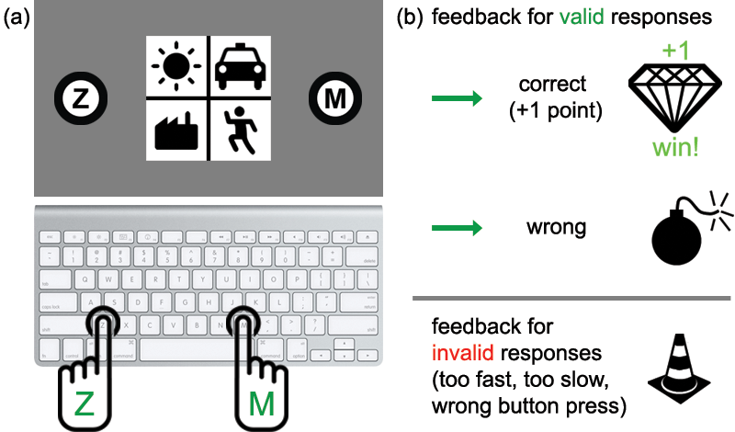
Satisficing Decision Making and Classification
Consider a classification problem :
Discrete feature random variables: X_{k} for k = 1,…,K
K is the number of the cues
The range of the cue random variable X_{k} :
n_{k} is the number of the possible values of the kth cue
Discrete class random variable: Z
The range of the class random variable Z :
n_{Z} is the number of the possible values of the class variable
Goal of Satisficing decision making: Make decision y in suboptimal conditions
K = 4
X₁: Weather
X₂: Transportation
X₃: Building
X₄: Activity
n_{Z} = 2
response window (5 s)
feedback
(training phase)
3
Notes:
3

Slide 4
Learning of Probability Model
Data Generation:
The data sets are generated according to an underlying joint probability mass function (PMF): P(Z, X₁, …, X_{k})
The PMF P(Z, X₁, …, X_{k}) is unknown for subjects in advance
Experiments include learning and testing phases:
In the learning phase: (N_{l} data samples)
Learning data set:
x_{i} = [x_{i,1},…, x_{i,K}] is the ith trial data and y_{i} is the decision
z_{i} is the corresponding feedback of the class (ground truth)
In the testing phase: (N_{t} data samples)
Testing data set:
No feedback is provided
4
Notes:
4
Furthermore in NCE the macroscopic state is defined in terms of the expectation of the evolving agent distribution

Slide 5
Passive Satisficing Task

Slide 6




















Problem formulation
Novel probabilistic classification task (buried treasure), which was inspired by the “weather prediction (WP) task” (Knowlton et al., 1994, 1996), to induce and track shifts in decision-making strategies.
Limited decision time: 1) No Time (NT) Pressure and 2) Time Pressure (TP)
Bayesian model: - One classification random variable, z, with Z = {L, R}
- Four (conditionally) independent cues
Abstract | Stimulus | Cue state
Cue |  | 1 | 2
Color (X₁) |  | Blue | Red
Shape (X₂) |  | Circle | Square
Contour (X₃) |  | White | Black
Line Orientation (X₄) |  | Horizontal | Vertical
16 unique stimuli
6
6
Notes:
6

Slide 7
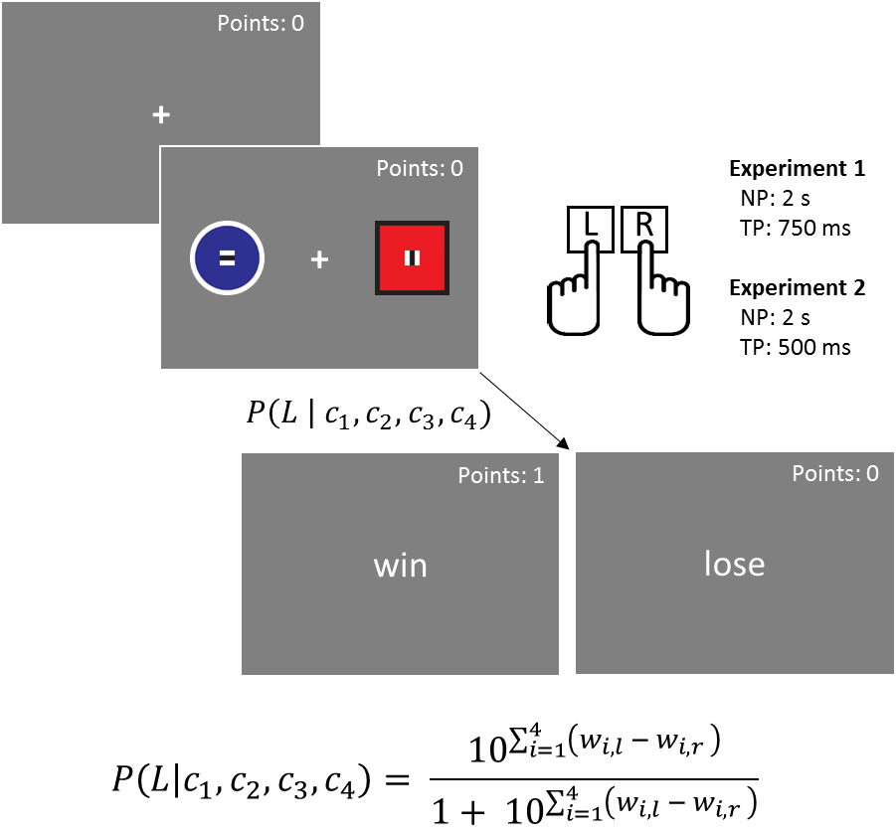
Human Behavioral Experiments
Experiment overview
Task
Phase 1: No Time Pressure (NP)
480 trials
2 sec. response window
Phase 2: Time Pressure (TP)
240 trials
Exp. 1: 750 ms TP (N = 45)
Exp. 2: 500 ms TP (N = 36)
7
7
Notes:
7

Slide 8
Human Behavioral Experiments
Findings from our previous research on human
(reported in the last review):
Human can learn the cue rankings
Human adopt a drop-the-worst cue decision making strategy
Ignore the cues with least information
Minimize cognitive time and effort investment
Preserving the consideration of the most diagnostic cue information
Maintain good-enough accuracy
The criterions of ranking and dropping these cues are not clear!
The relationship between human decision strategies and information values of the cues are investigated.
8
Notes:
8

Slide 9
Information value functions
Three different definitions of information values are investigated:
1. Information gain (IG) defines the expected uncertainty (Shannon entropy) reduction about the probabilities of the class Z by the cue X_{k}:
2. Probability gain (PG) defines the expected increase of the rewards in the maximum a posteriori (MAP) decision rule:
3. Impact (IMP) defines the expected mean of the absolute change from the prior to the posterior beliefs over all classes:
The probability gain and Impact are equivalent for the binary class case:
for n_{Z} = 2
9
Notes:
9
Furthermore in NCE the macroscopic state is defined in terms of the expectation of the evolving agent distribution

Slide 10
Information value functions
Three different definitions of information values are investigated:
1. Information gain (IG) is equivalent to the KL-divergence between the prior P(zn) and the posterior P(z_{n}|x_{k,j}):
2. Probability gain (PG) is the difference between the expected L- norm of the vector p_{post}(x_{k,j}) and the L-  norm of the vector p_{pri}:
3. Impact (IMP) is proportional to the expected L-1 norm of the difference between the vector p_{post}(x_{k,j}) and the vector p_{pri} :
where and
10
Notes:
10

Slide 11
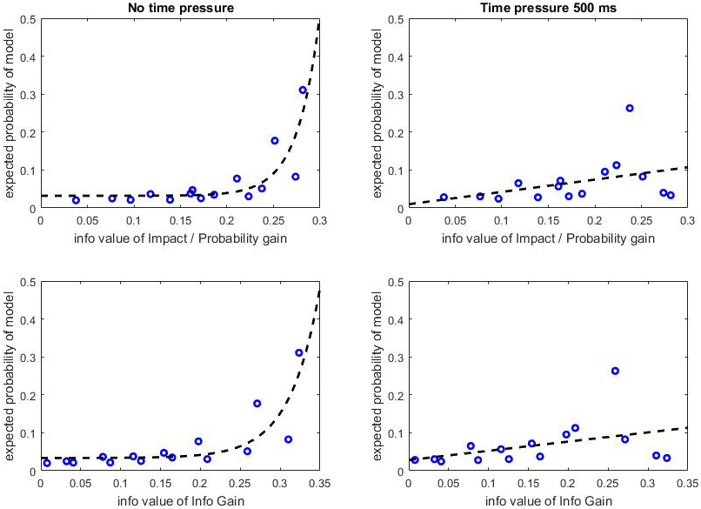
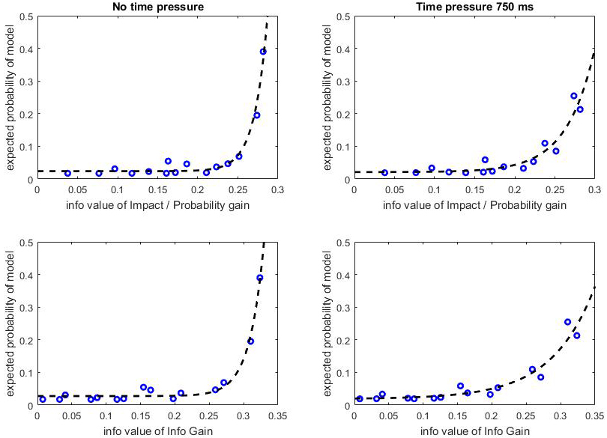
Analysis on Human Data Sets
Relationship between expected probabilities of strategies and info values
1) The expected probabilities of selected models increase monotonically with the increasing of different information values.
2) Human is able to figure out the information values of different models and select the model with the higher information values at higher probabilities.
Experiment 1 No time pressure v.s. low time pressure of 750 ms
11
Notes:
11
Fig. 1. The relationships between different information values and the expected probability of selected models. Each circle represents a model and there are 15 circles in each subfigure. On the left side the subfigures show the performances under no time pressure, while on the right side the subfigures show the performances under time pressure of 750 ms. The subfigures on the first, the second and the third rows show the performances of information values of impact, information gain and log diagnostic, respectively.
Fig. 2. The relationships between different information values and the expected probability of selected models. Each circle represents a model and there are 15 circles in each subfigure. On the left side the subfigures show the performances under no time pressure, while on the right side the subfigures show the performances under time pressure of 500 ms. The subfigures on the first, the second and the third rows show the performances of information values of impact, information gain and log diagnostic, respectively.
It can be observed from Fig. 2 that the expected probabilities of selected models increase monotonically with the increasing of different information values. It means that human is able to figure out the information values of different models and select the model with the higher information values at higher probabilities. However, in Fig. 3 this trend is not very obvious. The reason is that under high time pressure information value is not most important fact to select model by human. The complexity of models is considered under high time pressure. Therefore, some model with high information value, e.g. the model with all cues, is selected with a low probability.

Slide 12
Analysis on Human Data Sets
Relationship between expected probabilities of strategies and info values
1) The expected probabilities of selected models increase monotonically with the increasing of different information values.
2) Human is able to figure out the information values of different models and select the model with the higher information values at higher probabilities.
Experiment 2 No time pressure v.s. high time pressure of 500 ms
12
Notes:
12
Fig. 1. The relationships between different information values and the expected probability of selected models. Each circle represents a model and there are 15 circles in each subfigure. On the left side the subfigures show the performances under no time pressure, while on the right side the subfigures show the performances under time pressure of 750 ms. The subfigures on the first, the second and the third rows show the performances of information values of impact, information gain and log diagnostic, respectively.
Fig. 2. The relationships between different information values and the expected probability of selected models. Each circle represents a model and there are 15 circles in each subfigure. On the left side the subfigures show the performances under no time pressure, while on the right side the subfigures show the performances under time pressure of 500 ms. The subfigures on the first, the second and the third rows show the performances of information values of impact, information gain and log diagnostic, respectively.
It can be observed from Fig. 2 that the expected probabilities of selected models increase monotonically with the increasing of different information values. It means that human is able to figure out the information values of different models and select the model with the higher information values at higher probabilities. However, in Fig. 3 this trend is not very obvious. The reason is that under high time pressure information value is not most important fact to select model by human. The complexity of models is considered under high time pressure. Therefore, some model with high information value, e.g. the model with all cues, is selected with a low probability.

Slide 13
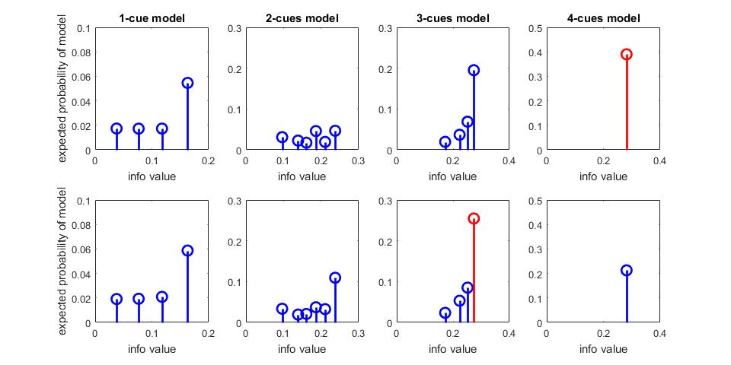
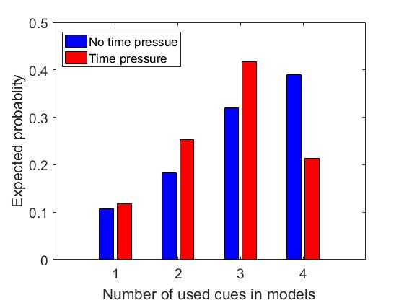
Analysis on Human Data Sets
Relationship between expected probabilities of strategies and info values
Experiment 1 No time pressure v.s. low time pressure of 750 ms
in most cases given a certain number of the used cues, human prefer to select the model with largest information values;
when no time pressure is applied, human prefer to select model with all cues, while when time pressure is applied, human drop some cues to make decisions.
13
Notes:
13
Fig. 1. The relationships between different information values and the expected probability of selected models. Each circle represents a model and there are 15 circles in each subfigure. On the left side the subfigures show the performances under no time pressure, while on the right side the subfigures show the performances under time pressure of 750 ms. The subfigures on the first, the second and the third rows show the performances of information values of impact, information gain and log diagnostic, respectively.
Fig. 2. The relationships between different information values and the expected probability of selected models. Each circle represents a model and there are 15 circles in each subfigure. On the left side the subfigures show the performances under no time pressure, while on the right side the subfigures show the performances under time pressure of 500 ms. The subfigures on the first, the second and the third rows show the performances of information values of impact, information gain and log diagnostic, respectively.
It can be observed from Fig. 2 that the expected probabilities of selected models increase monotonically with the increasing of different information values. It means that human is able to figure out the information values of different models and select the model with the higher information values at higher probabilities. However, in Fig. 3 this trend is not very obvious. The reason is that under high time pressure information value is not most important fact to select model by human. The complexity of models is considered under high time pressure. Therefore, some model with high information value, e.g. the model with all cues, is selected with a low probability.

Slide 14
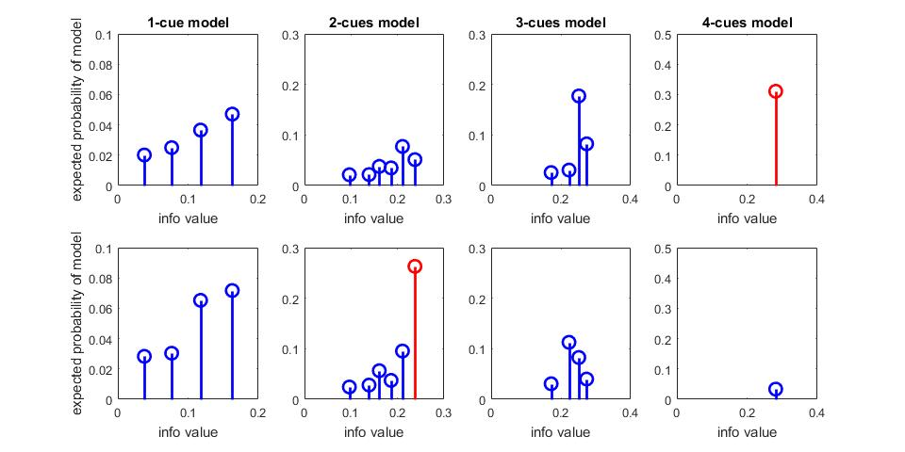
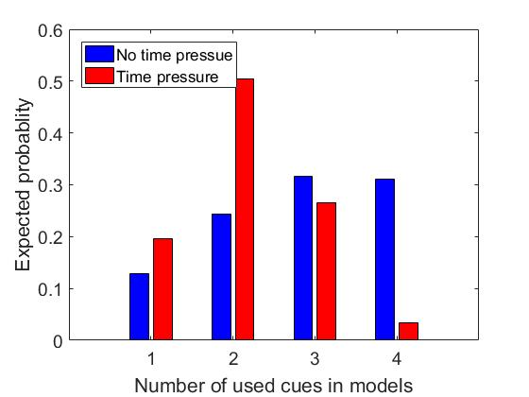
Analysis on Human Data Sets
Relationship between expected probabilities of strategies and info values
Experiment 2 No time pressure v.s. low time pressure of 500 ms
in most cases given a certain number of the used cues, human prefer to select the model with largest information values;
when no time pressure is applied, human prefer to select model with all cues, while when time pressure is applied, human drop some cues to make decisions.
14
Notes:
14
Fig. 1. The relationships between different information values and the expected probability of selected models. Each circle represents a model and there are 15 circles in each subfigure. On the left side the subfigures show the performances under no time pressure, while on the right side the subfigures show the performances under time pressure of 750 ms. The subfigures on the first, the second and the third rows show the performances of information values of impact, information gain and log diagnostic, respectively.
Fig. 2. The relationships between different information values and the expected probability of selected models. Each circle represents a model and there are 15 circles in each subfigure. On the left side the subfigures show the performances under no time pressure, while on the right side the subfigures show the performances under time pressure of 500 ms. The subfigures on the first, the second and the third rows show the performances of information values of impact, information gain and log diagnostic, respectively.
It can be observed from Fig. 2 that the expected probabilities of selected models increase monotonically with the increasing of different information values. It means that human is able to figure out the information values of different models and select the model with the higher information values at higher probabilities. However, in Fig. 3 this trend is not very obvious. The reason is that under high time pressure information value is not most important fact to select model by human. The complexity of models is considered under high time pressure. Therefore, some model with high information value, e.g. the model with all cues, is selected with a low probability.

Slide 15
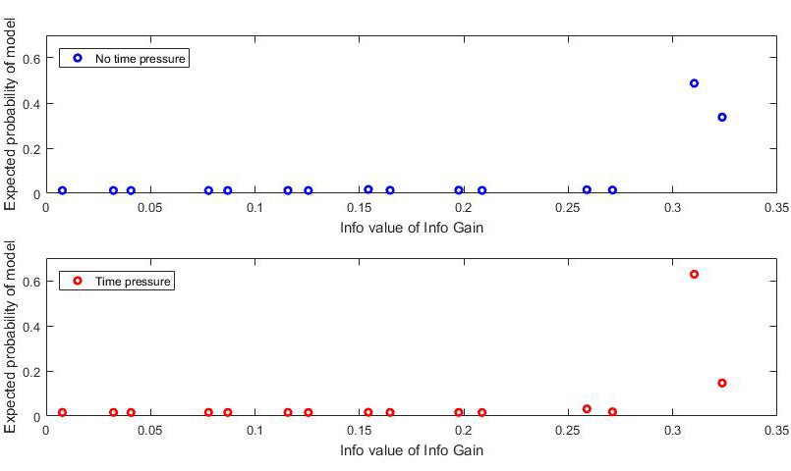
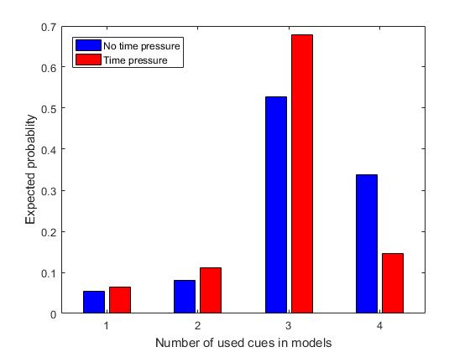
Analysis on Primates Data Sets
Relationship between expected probabilities of strategies and info values
Similar experiments are conducted with primates.
In the experiment of primates with no time pressure, the response time is larger than 1.75 s, while in the experiment with time pressure the response time is less than 0.5 s.
Expected probabilities of the models with larger values are also higher
When time pressure is applied, primates drop some cues to make decisions.
15
Notes:
15
Fig. 1. The relationships between different information values and the expected probability of selected models. Each circle represents a model and there are 15 circles in each subfigure. On the left side the subfigures show the performances under no time pressure, while on the right side the subfigures show the performances under time pressure of 750 ms. The subfigures on the first, the second and the third rows show the performances of information values of impact, information gain and log diagnostic, respectively.
Fig. 2. The relationships between different information values and the expected probability of selected models. Each circle represents a model and there are 15 circles in each subfigure. On the left side the subfigures show the performances under no time pressure, while on the right side the subfigures show the performances under time pressure of 500 ms. The subfigures on the first, the second and the third rows show the performances of information values of impact, information gain and log diagnostic, respectively.
It can be observed from Fig. 2 that the expected probabilities of selected models increase monotonically with the increasing of different information values. It means that human is able to figure out the information values of different models and select the model with the higher information values at higher probabilities. However, in Fig. 3 this trend is not very obvious. The reason is that under high time pressure information value is not most important fact to select model by human. The complexity of models is considered under high time pressure. Therefore, some model with high information value, e.g. the model with all cues, is selected with a low probability.

Slide 16
Active Satisficing Task

Slide 17
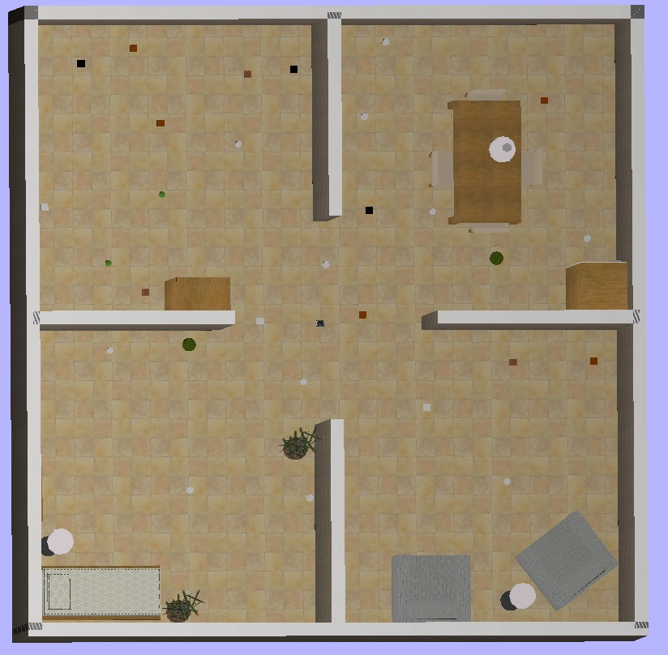
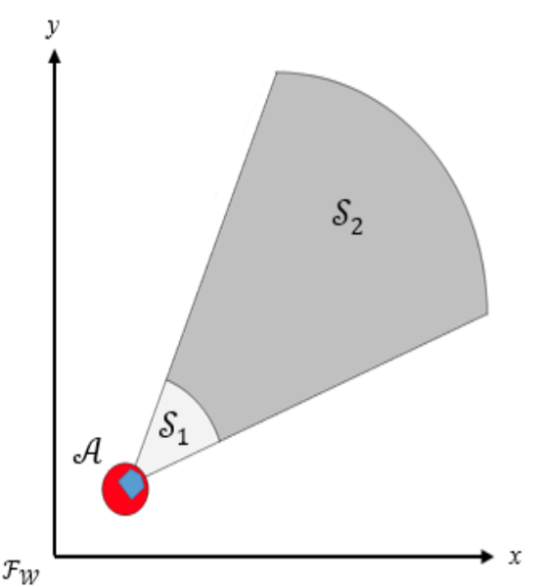
WeBot Environment
WeBot environment:
Robot configuration:
α = π/4
robot initial location
Can see the object within S₂
Can interact with targets within S₁
Robot configuration: [x y θ]^{T}
30 targets, locations randomly picked from candidates

Slide 18

Learning Phase
Objects appear without any cues revealed.
Tester receives correct/incorrect result after each classification, and the correct rate updates
No time limit/ coin limit.

Slide 19
Testing Phase
Three testing phase: 1. No pressure. 2. Coin pressure only. 3. With fog.
Correct/ incorrect result is not given.

Slide 20
Testing with Fog

Slide 21
Active Satisficing Task --Field of View (FOV) and C-target Construction

Slide 22
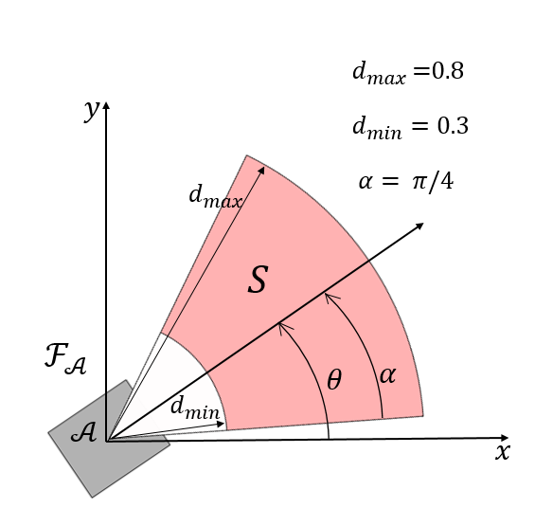
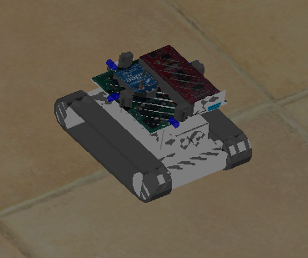
Field of View (FOV)
FOV is determined based on human tests and visual classification projects
Robot configuration: [x y θ]^{T}
θ ϵ (-π, π)
θ
y
x

Slide 23
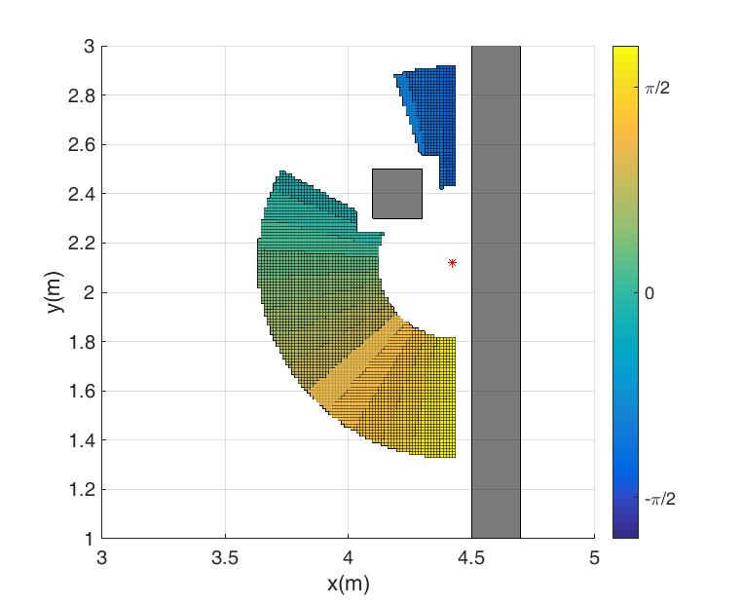
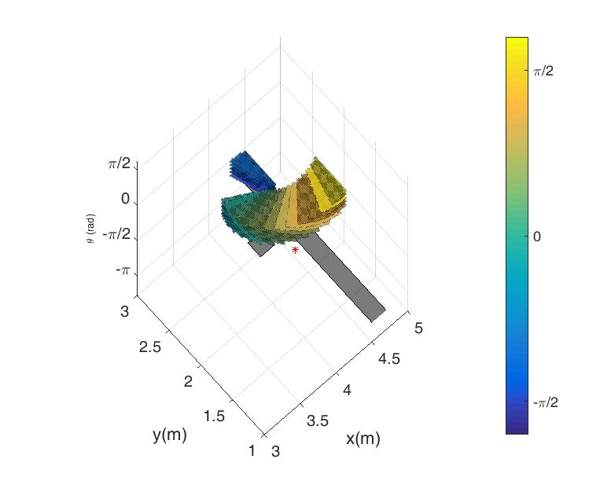
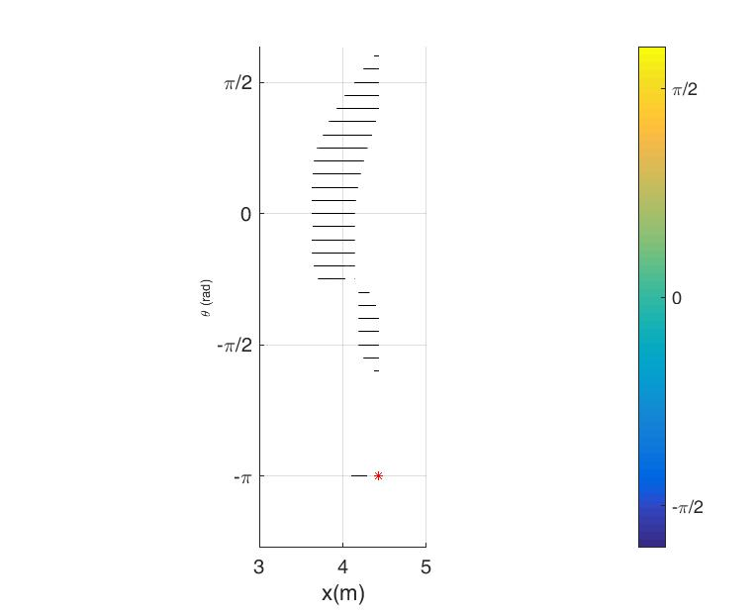
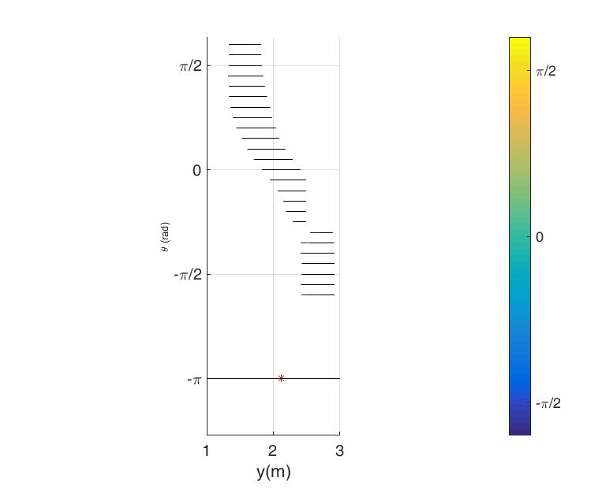
C-target Case Demonstration
x-y view
obstacles
target
x-θ view y- θ view

Slide 24
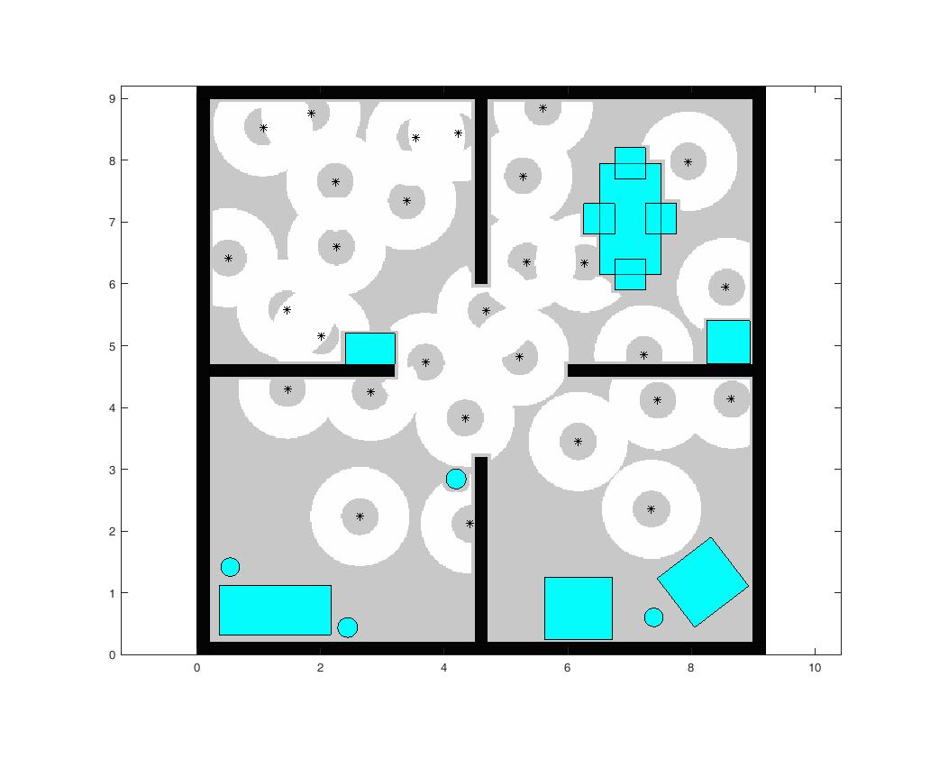
X-Y Projection of C-Target
WeBot environment top view:
Simulated C-Target in x-y plane:

Slide 25
Active Satisficing Task --Cue Value Extraction by Image Processing

Slide 26
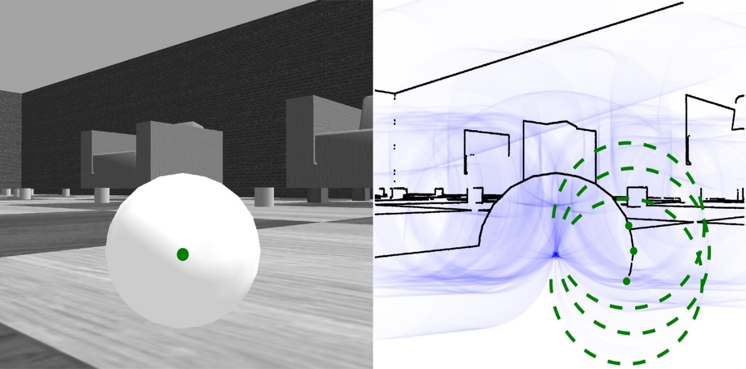
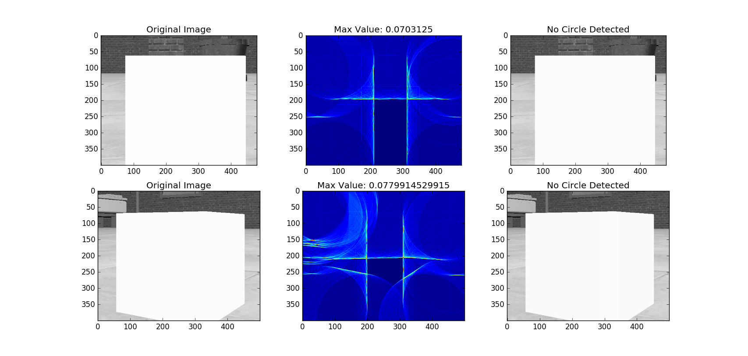
Shape Detection by Circular Hough Transform
Perform edge detection on a grayscale image
Draw a circle with a radius r_{specific} for each edge point in the subspace of Hough space

Slide 27
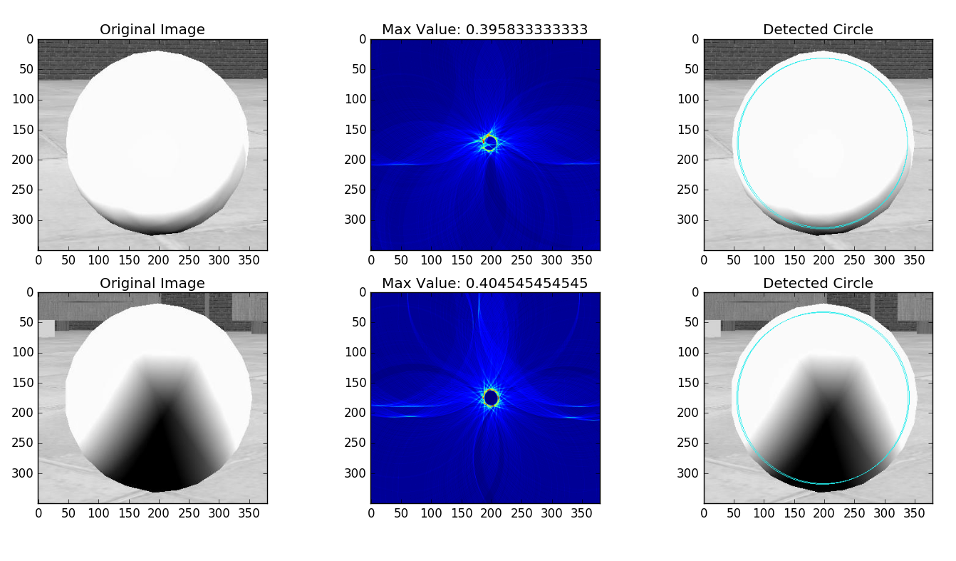
Circular Hough Transform with Shadow

Slide 28
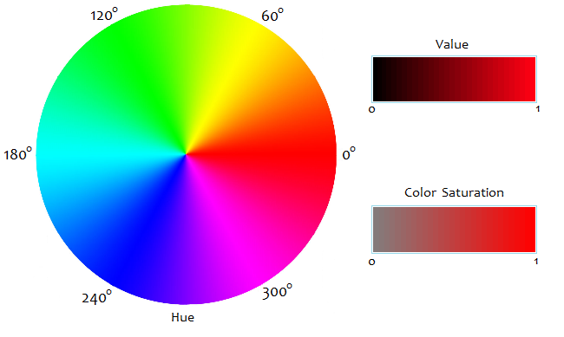
Color Appearance Parameters
Two ways to generate feature vector:
Mean value of R,G,B respectively: [𝑅, 𝐺, 𝐵]
Transform RGB values into hue, saturation and value (HSV) and use Hue as the feature

Slide 29
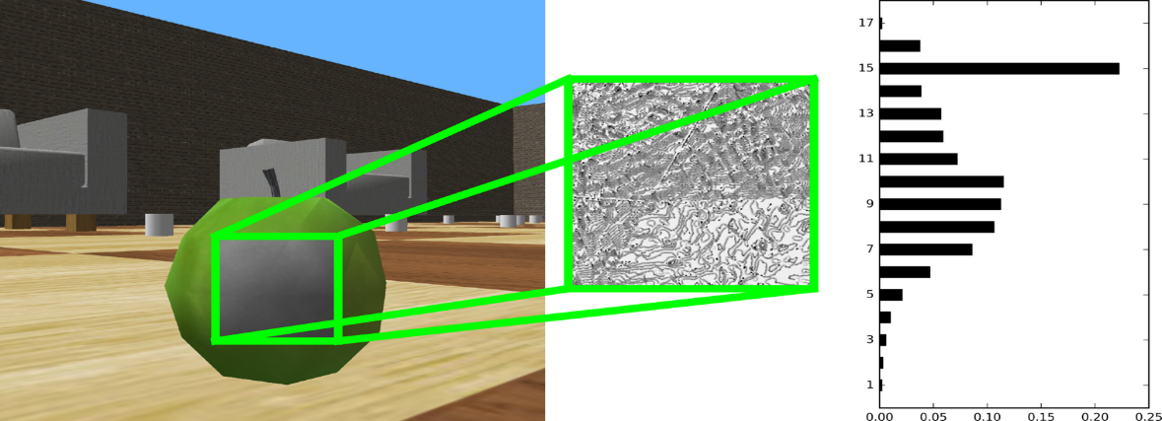
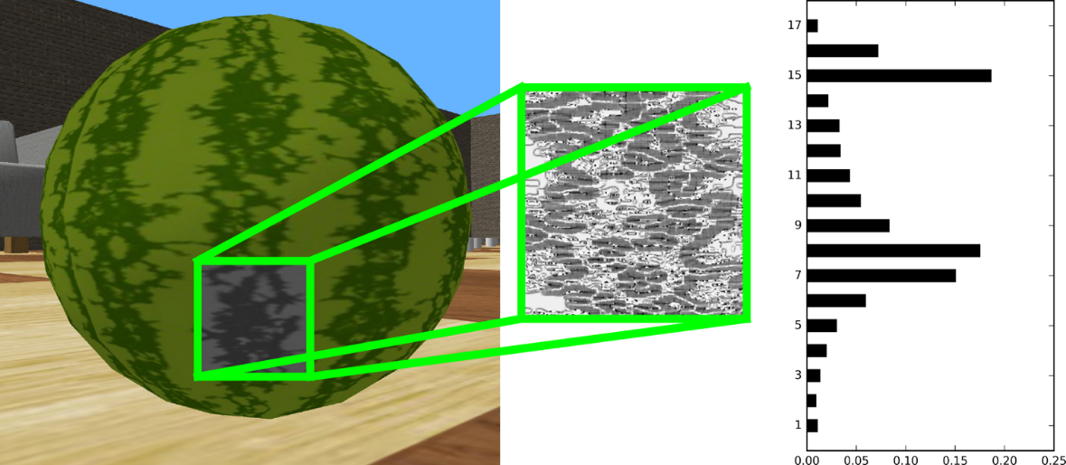
Texture Detection Using Local Binary Patterns
Using a boolean comparison of each pixel’s brightness relative to that of its neighbors.

Slide 30
Active Satisficing Task -- Expected Entropy Reduction (EER) Approach

Slide 31
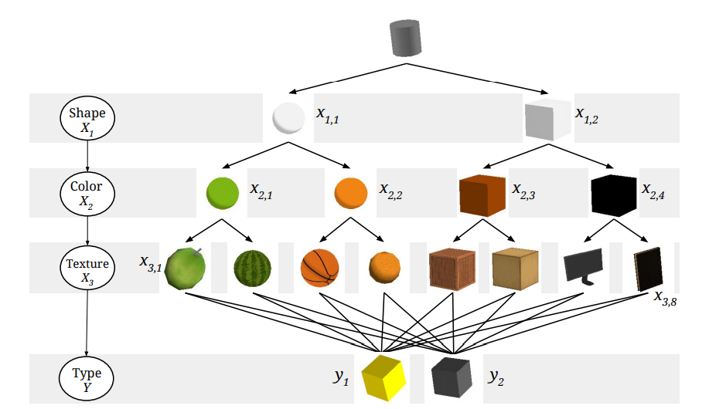
Expected Entropy Reduction Approach
Baysian network structure:
?
?
Shape
X₁
Color
X₂
Texture
X₃
Type
Y

Slide 32
Single-Step EER Calculation
Expected entropy reduction (EER) of distribution of random variable Y.
?
1. Revealing X₁ (Shape) with no prior cue:
?
1
EER (X₁) = H(P(Y )) – H(P(Y | X₁))
Shape
X₁
2. Revealing X₂ (Color) knowing X₁ (Shape) :
2
EER (X₁ = x_{1,i}, X₂) = H(P(Y |X₁ = x_{1,i})) - H(P(Y |X₁ = x_{1,i}, X₂))
Color
X₂
3. Revealing X₃ (Texture) knowing X₁ (Shape) and X₂ (Color) :
3
Texture
X₃
EER (X₁ = x_{1,i}, X₂ = x_{2,j}, X₃)
= H(P(Y |X₁ = x_{1,i}, X₂ = x_{2,j})) - H(P(Y |X₁ = x_{1,i}, X₂ = x_{2,j}, X₃))
Type
Y

Slide 33
Single Step EER Demonstration
?
?
0.0317
Shape
X₁
0.0593
0
Color
X₂
0.4633
0
0
0
Texture
X₃
Type
Y

Slide 34
Multi-Steps EER Calculation
Expected entropy reduction (EER) of distribution of random variable Y.
1. Revealing X₁ (Shape) and X₂ (Color) with no prior cue (two-steps):
?
?
1
3
EER (X₁, X₂) = H(P(Y )) – H(P(Y |X_{1,} X₂))
Shape
X₁
2. Revealing X₃ (Texture) knowing X₁ (Shape) (two-steps):
Color
X₂
EER (X₁ = x_{1,i}, X_{2,} X₃)
= H(P(Y |X₁ = x_{1,i}) – H(P(Y |X₁ = x_{1,i,} X_{2,} X₃))
2
Texture
X₃
3. Revealing X₃ (Texture) with no prior cue (three-steps):
EER (X₁, X₂ , X₃) = H(P(Y )) – H(P(Y |X₁, X₂ , X₃))
Type
Y

Slide 35
Two-Steps/ Three-Steps EER Demonstration
Two-Steps/ Three-Steps
?
?
0.0572
Shape
X₁
0.1847
0.3558
0
Color
X₂
Texture
X₃
Type
Y

Slide 36
Active Satisficing Task -- DiVE

Slide 37
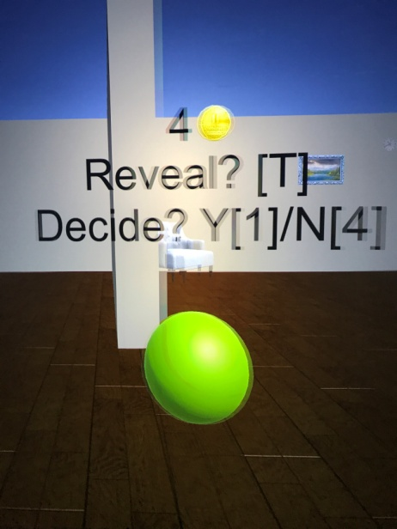
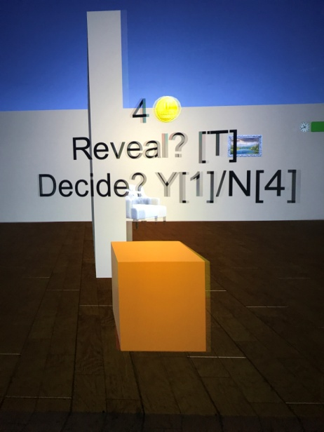
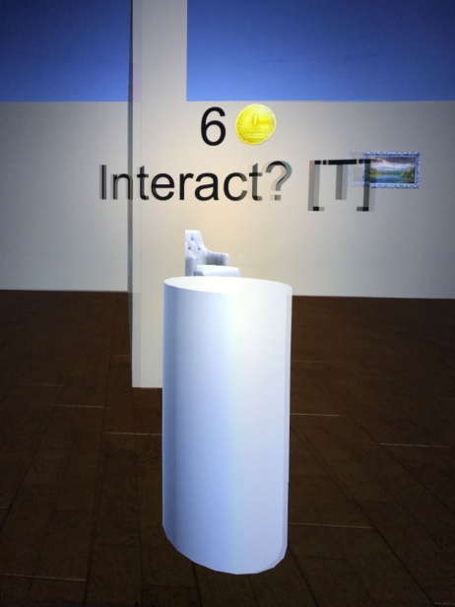
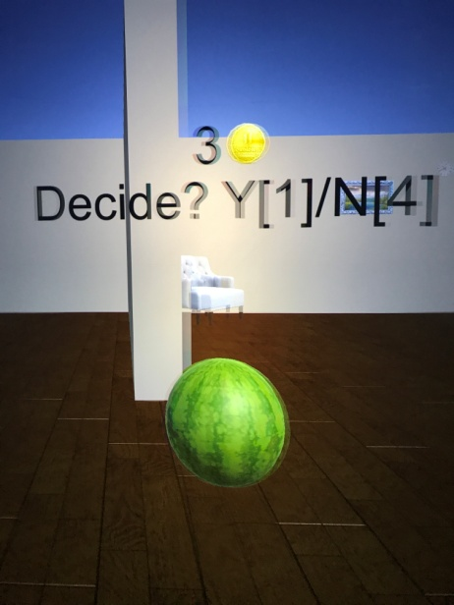
DiVE Environment
The same type of active satisficing experiments were imported into the Duke immersive Virtual Environment (DiVE) through important programming efforts.
A cave automatic virtual environment
Six projector screens forming a 3m x 3m x 3m cube around the subject
A full 360-degree perspective of the environment

Slide 38
DiVE Demo

Slide 39
Questions?
Thank you

